Slide 1
Styles and Layout

Slide 2
Objectives
Styling techniques for React-Native components
Set width and height for React Native components
Understanding how to create layouts for React Native apps

Slide 3
Styles

Slide 4
Basic - Styling
With React Native, you style your application using JavaScript.
All of the core components accept a prop named style.
The style names and values usually match how CSS works on the web, except names are written using camel casing, e.g. backgroundColor rather than background-color.
The style prop can be a plain old JavaScript object.

Slide 5
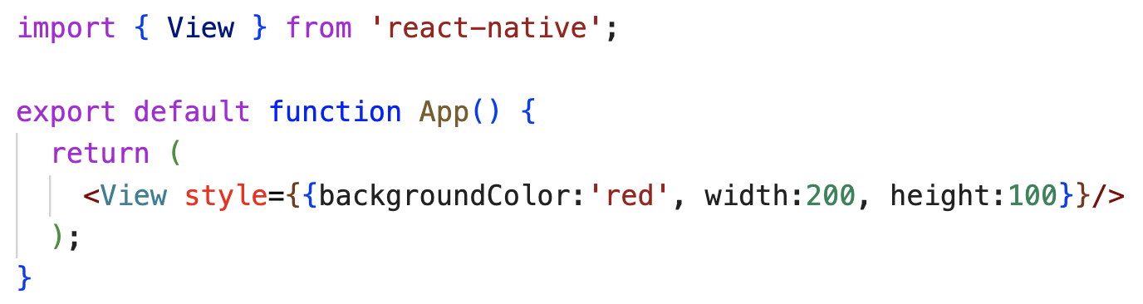
Inline style
Basic - Styling

Slide 6
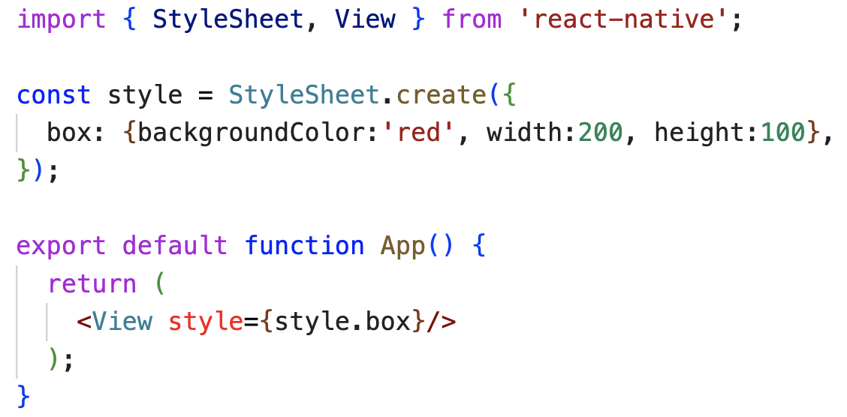
The React Native StyleSheet API
Basic - Styling

Slide 7
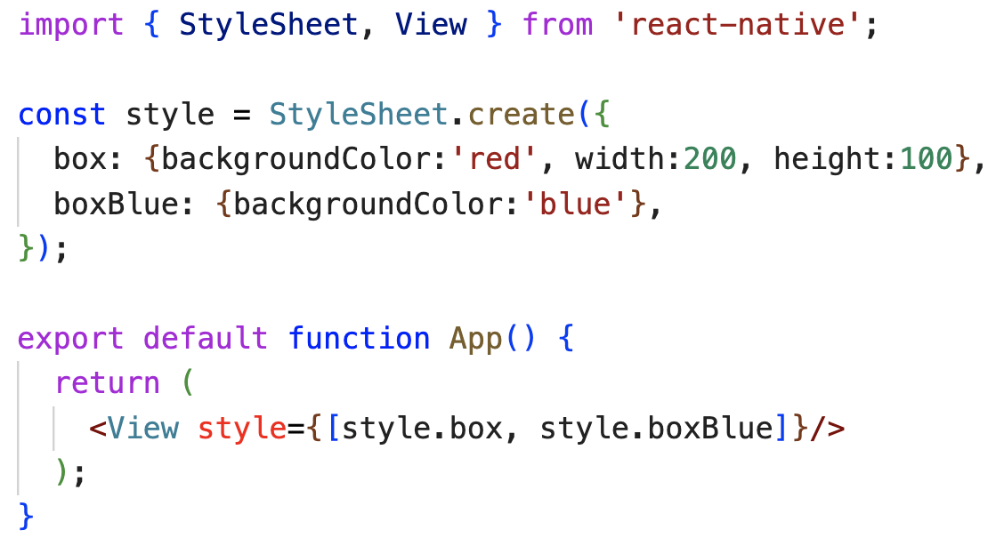
Passing an array to the style prop
Basic - Styling
The last items in the array will override properties defined previously.

Slide 8
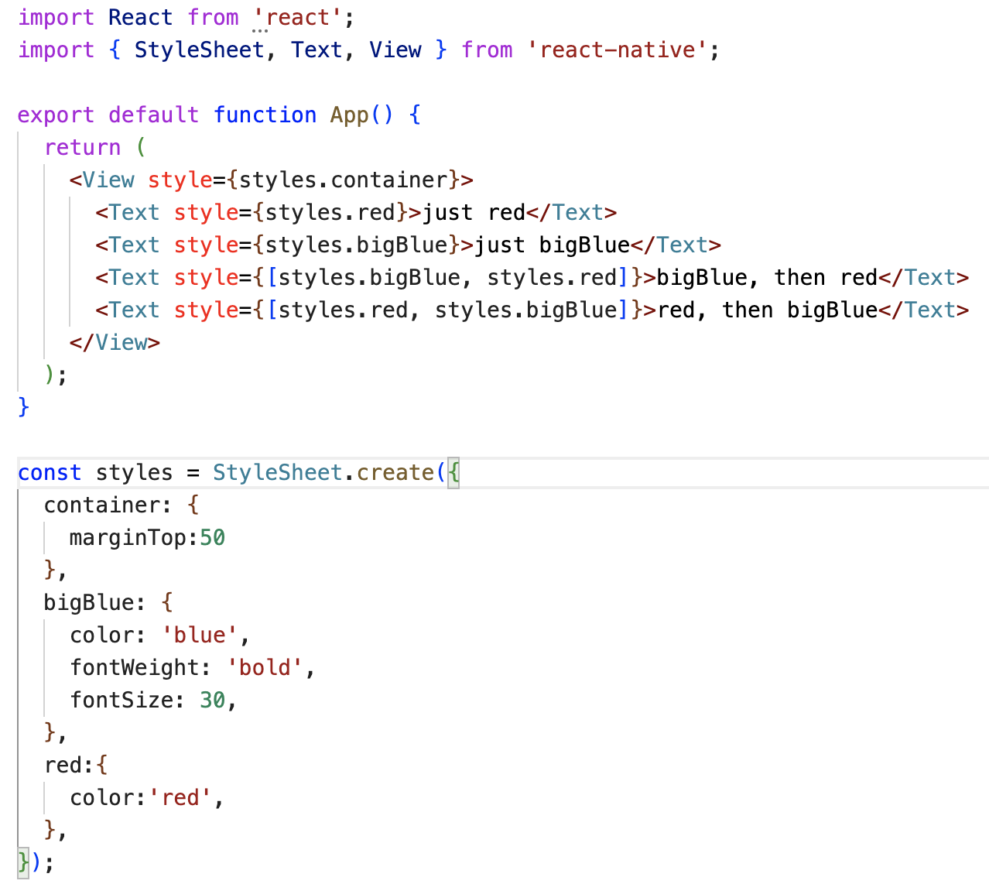
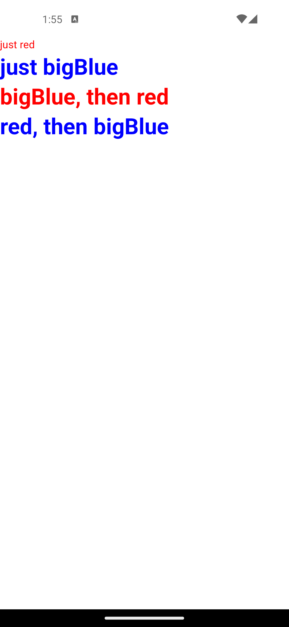
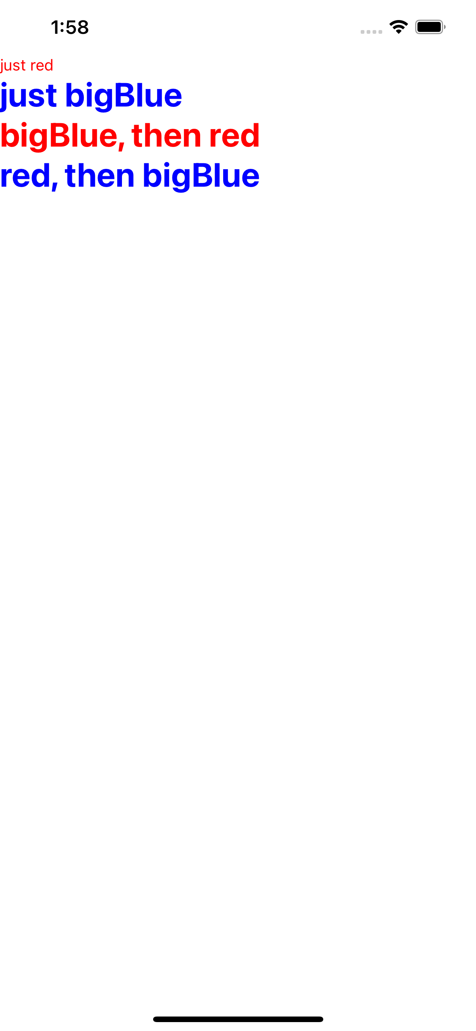
Demo:
Basic - Styling

Slide 9
Height - Width

Slide 10
Fixed Dimensions
Height and Width
A component's height and width determine its size on the screen.
The general way to set the dimensions of a component is by adding a fixed width and height to the style.
All dimensions in React Native are unitless and represent density-independent pixels.

Slide 11
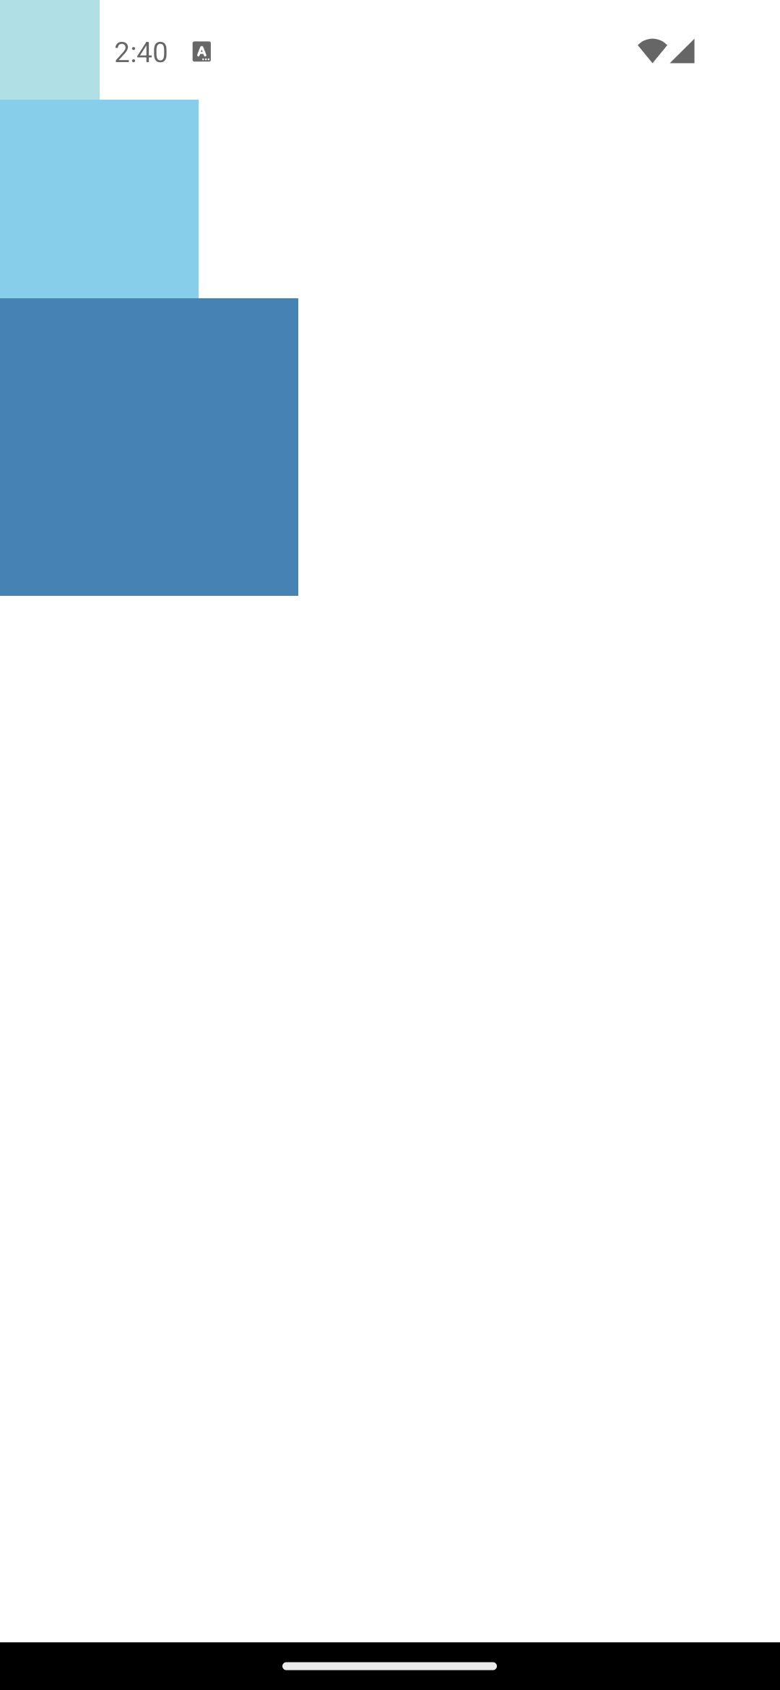
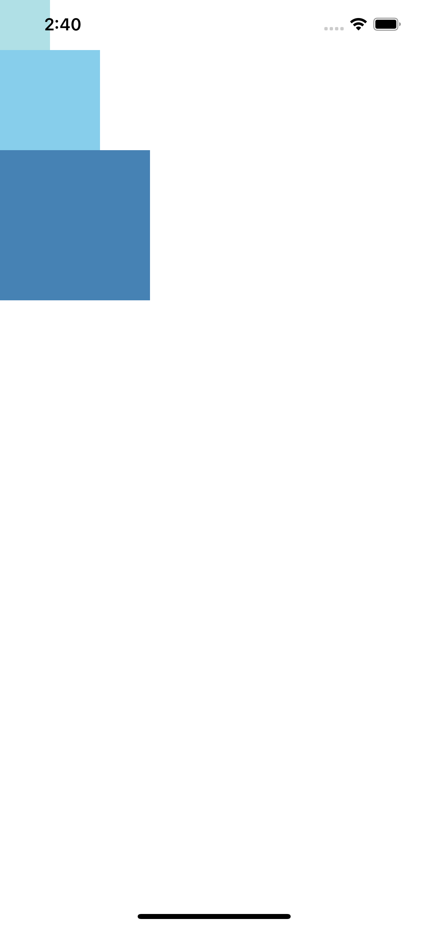
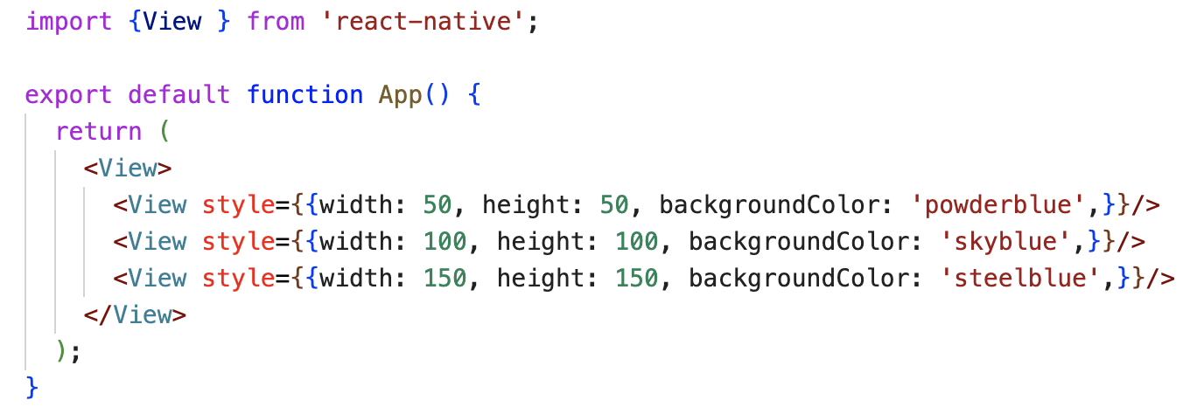
Fixed Dimensions
Height and Width
Setting dimensions this way is common for components whose size should always be fixed to a number of points and not calculated based on screen size.

Slide 12
Flex Dimensions
Height and Width
Use flex in a component's style to have the component expand and shrink dynamically based on available space.
Normally you will use flex: 1, which tells a component to fill all available space, shared evenly amongst other components with the same parent.
The larger the flex given, the higher the ratio of space a component will take compared to its siblings.

Slide 13
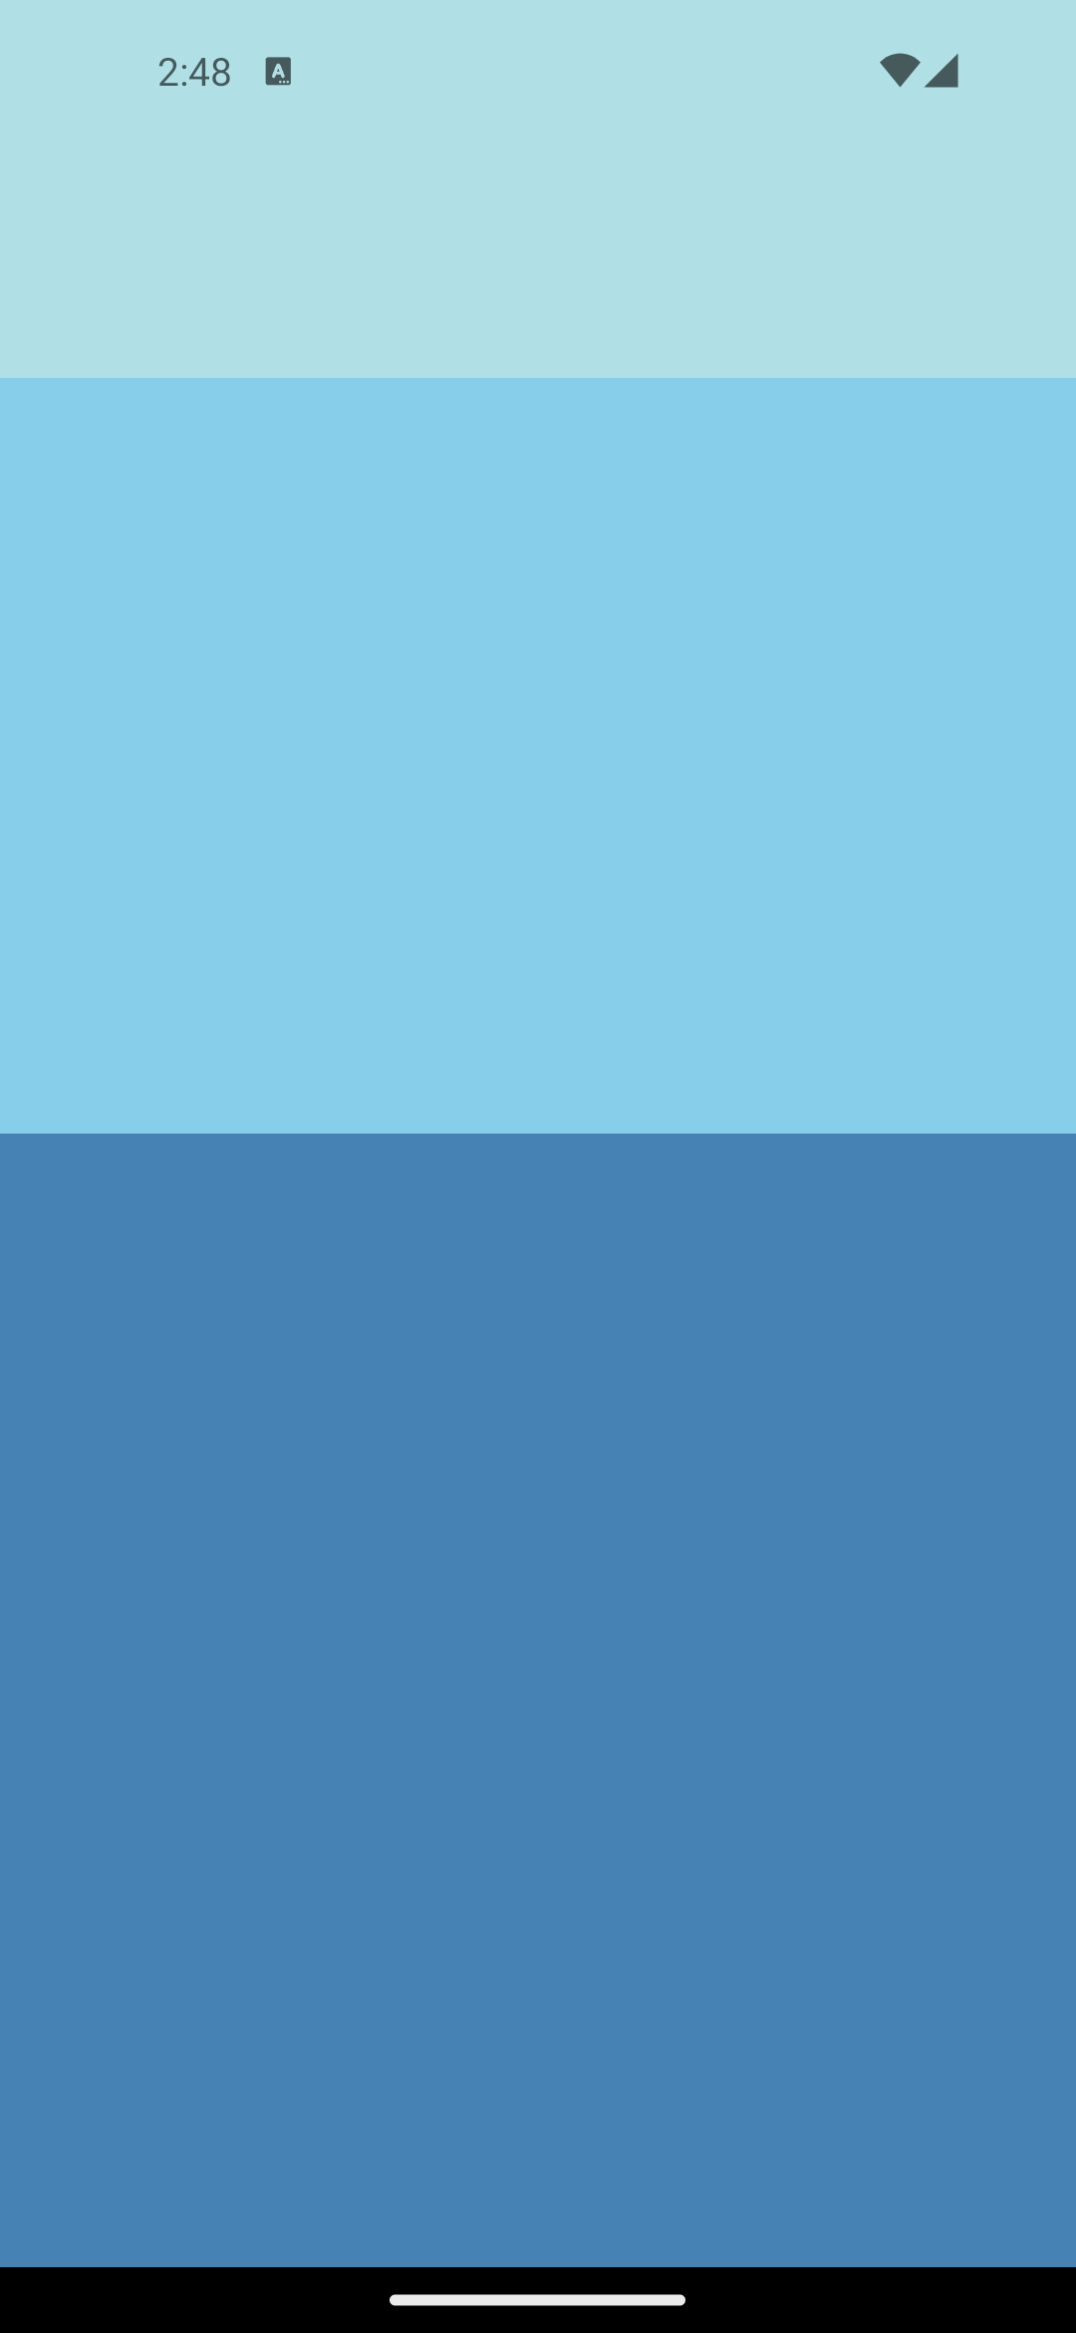
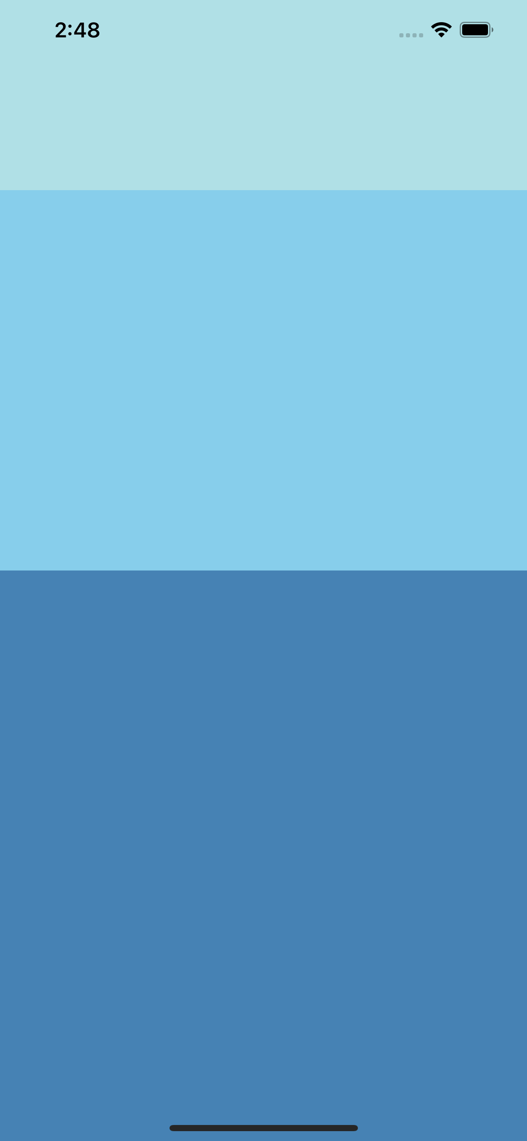
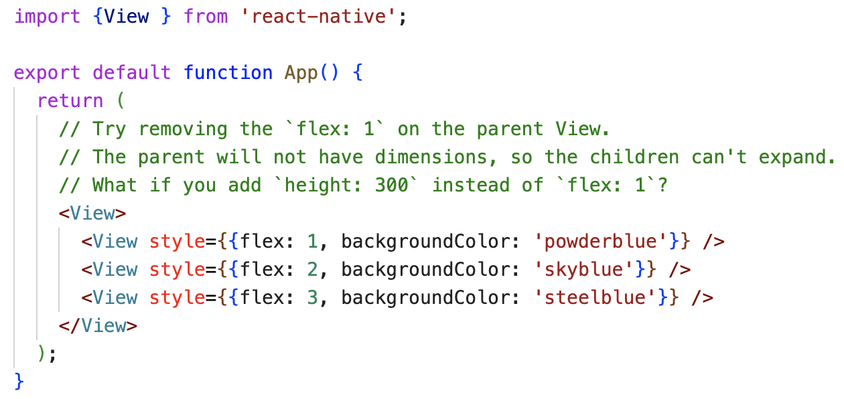
Flex Dimensions
Height and Width

Slide 14
Percentage Dimensions
Height and Width
If you want to fill a certain portion of the screen, but you don't want to use the flex layout, you can use percentage values in the component's style
Similar to flex dimensions, percentage dimensions require parent with a defined size.

Slide 15
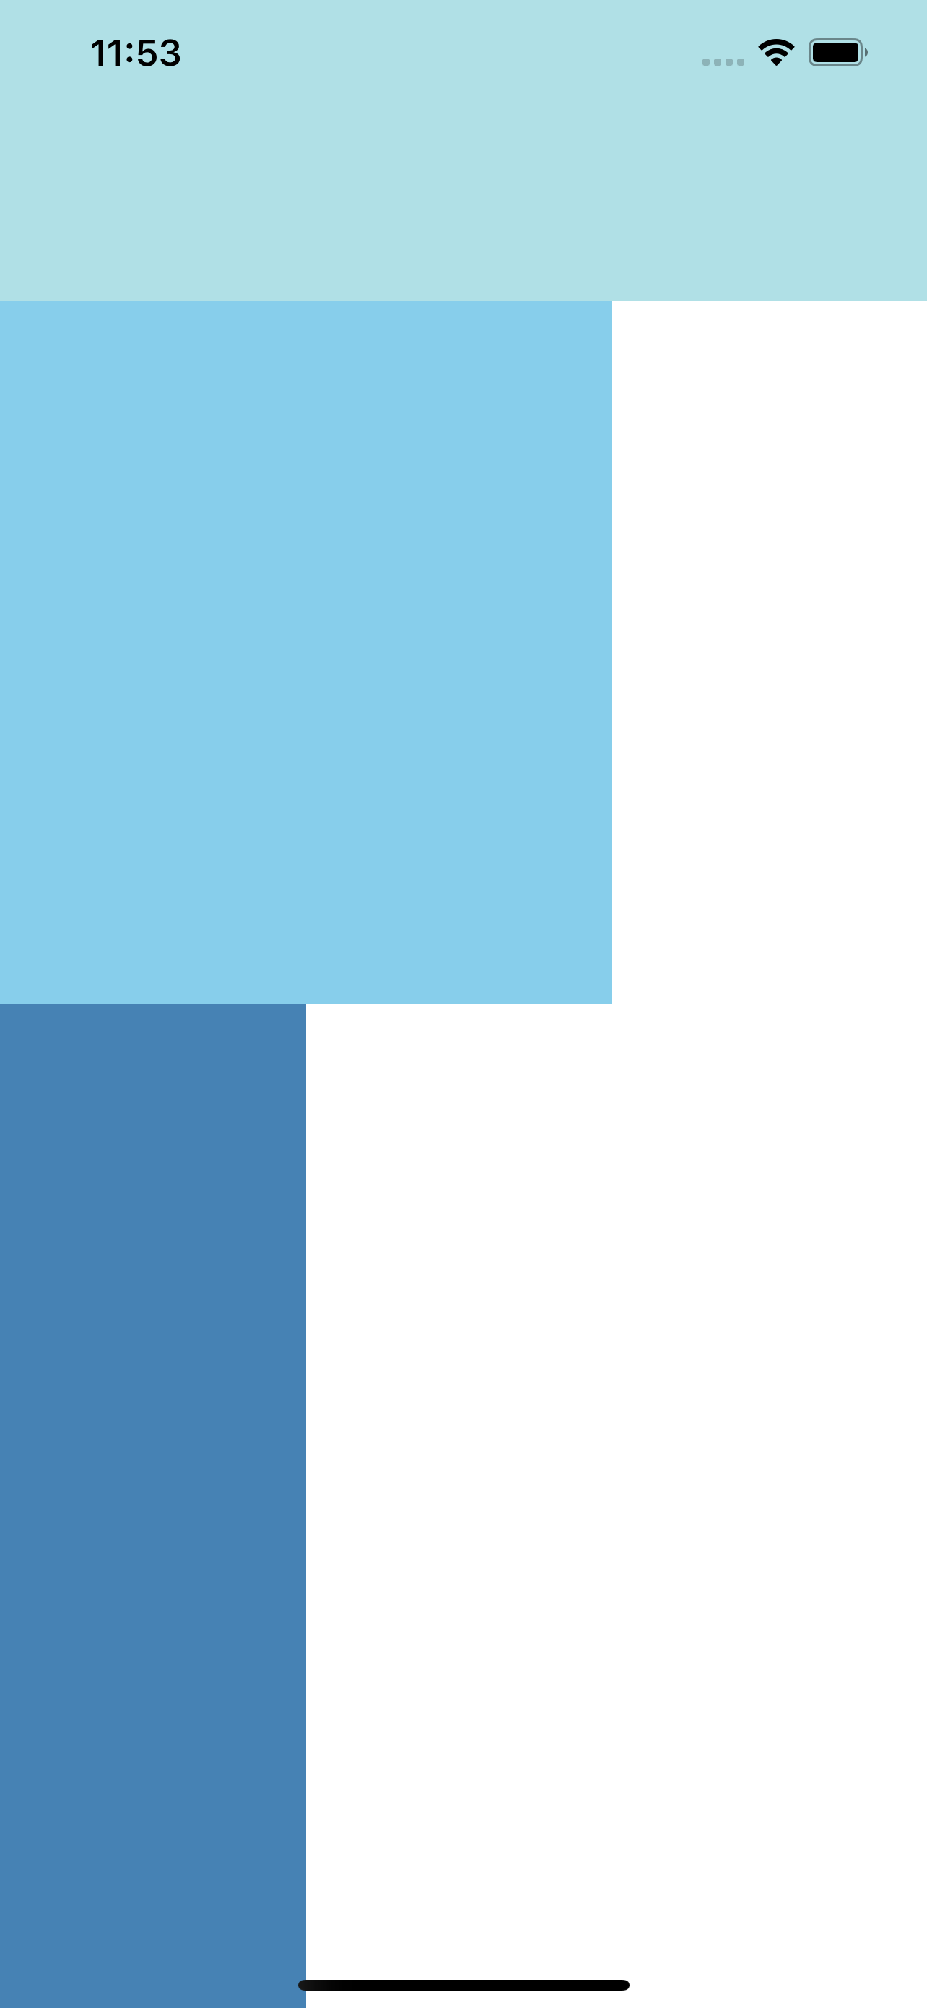
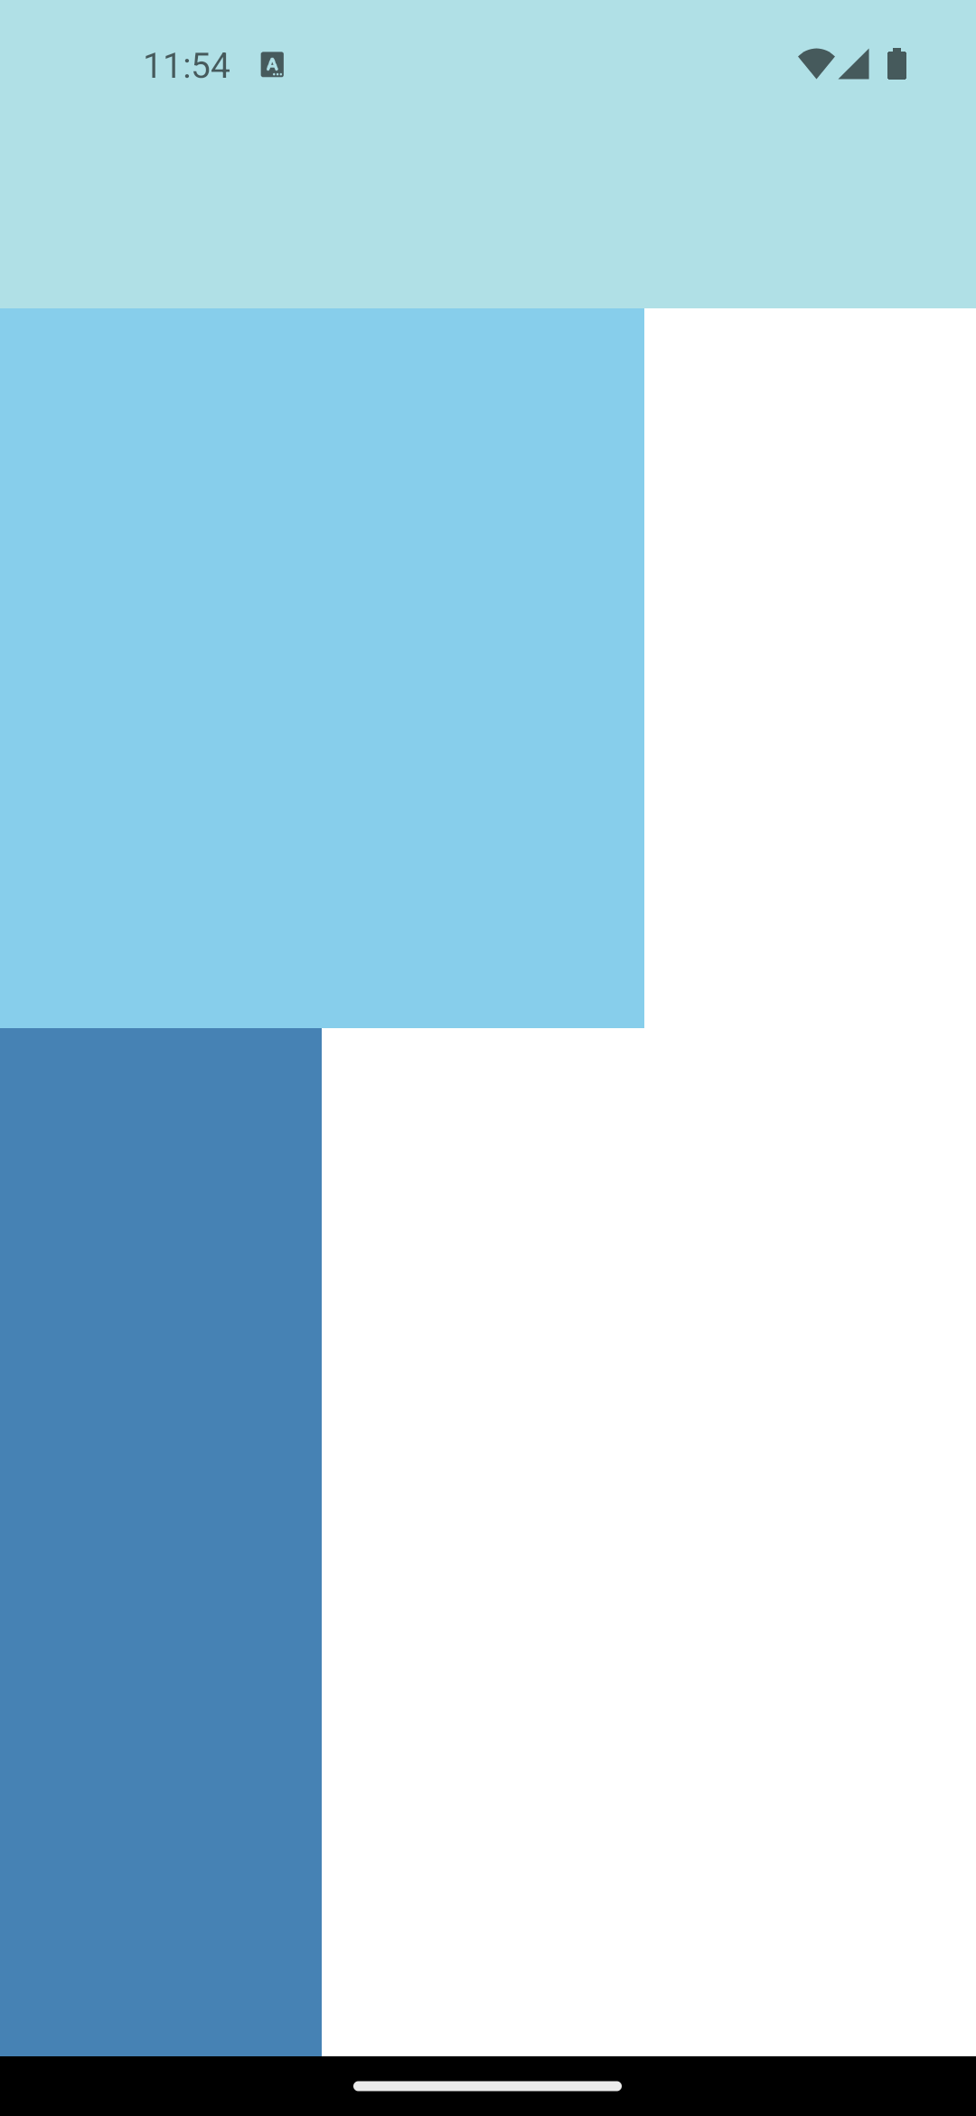
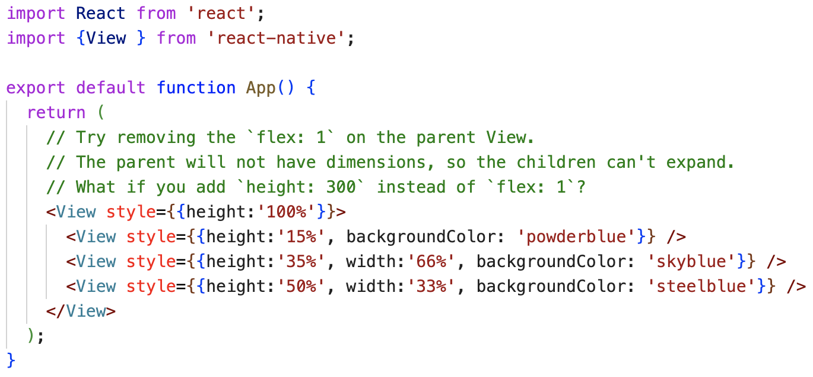
Percentage Dimensions
Height and Width

Slide 16
Layout

Slide 17
Layout
A component can specify the layout of its children using the Flexbox algorithm.
Flexbox is designed to provide a consistent layout on different screen sizes.
Flexbox works the same way in React Native as it does in CSS on the web, with a few exceptions. The defaults are different:
flexDirection defaulting to column instead of row.
alignContent defaulting to flex-start instead of stretch,
flexShrink defaulting to 0 instead of 1,
The flex parameter only supporting a single number.

Slide 18
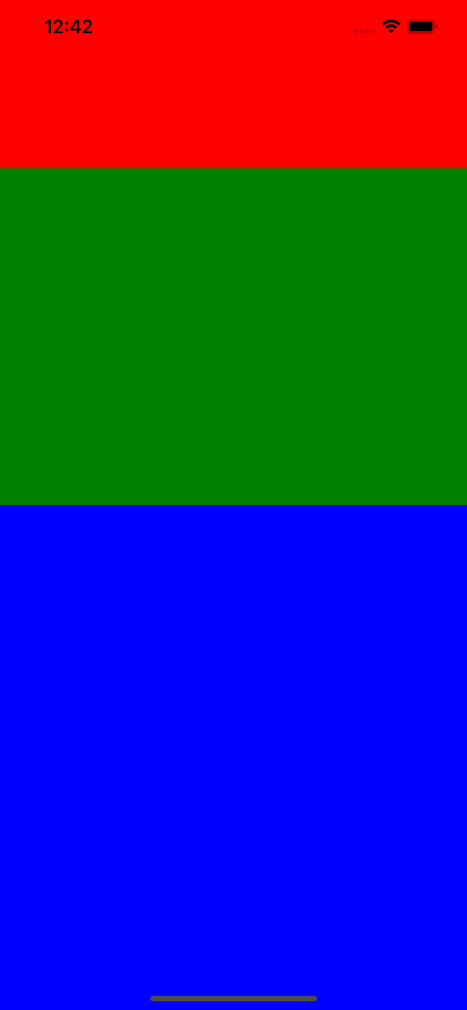
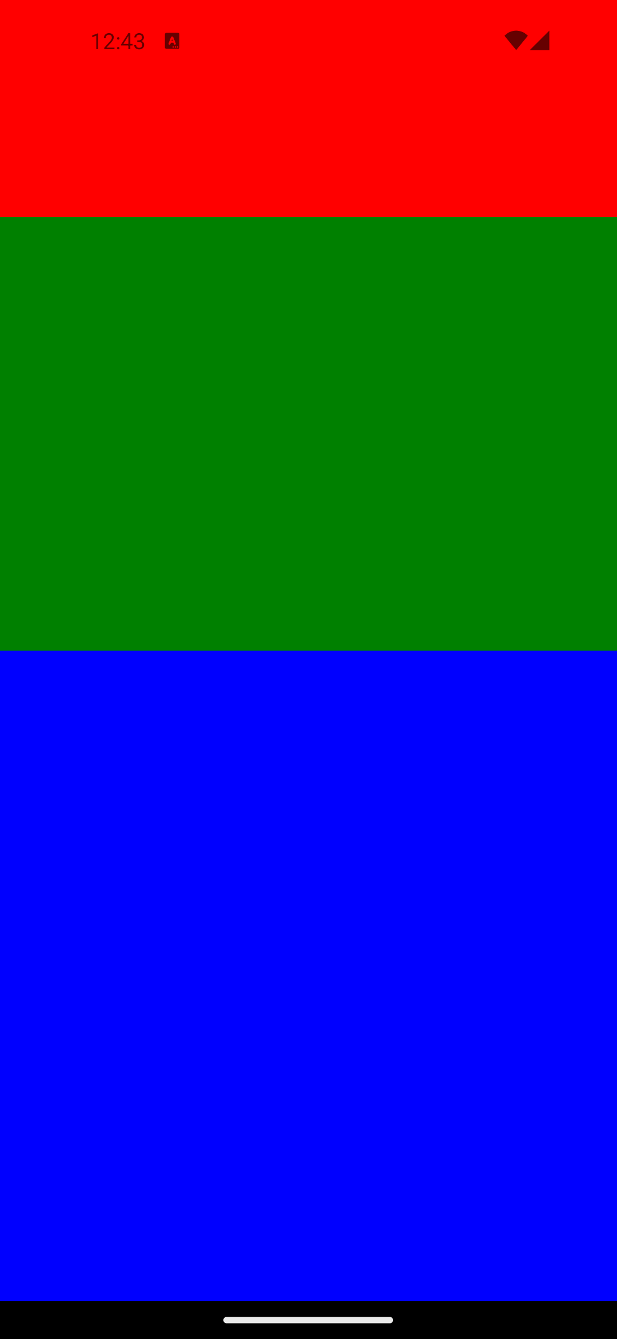
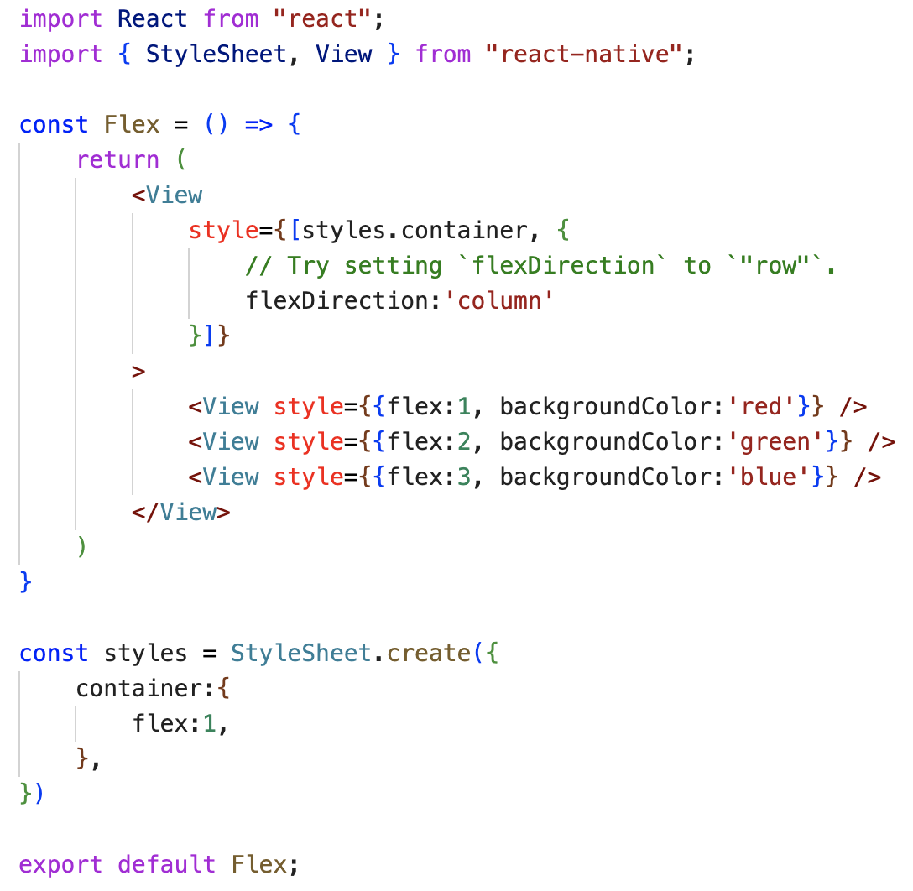
Flex
Layout
In the following example, the red, green, and blue views are all children in the container view that has flex: 1 set.
The red view uses flex: 1
The green view uses flex: 2,
The blue view uses flex: 3 .
1+2+3 = 6, which means that the red view will get 1/6 of the space, the green 2/6 of the space, and the blue 3/6 of the space.

Slide 19
Flex Direction
Layout
flexDirection controls the direction in which the children of a node are laid out.
This is also referred to as the main axis.
The cross axis is the axis perpendicular to the main axis, or the axis which the wrapping lines are laid out in.

Slide 20
Flex Direction
Layout
column (default value): Align children from top to bottom. If wrapping is enabled, then the next line will start to the right of the first item on the top of the container.
row: Align children from left to right. If wrapping is enabled, then the next line will start under the first item on the left of the container.
column-reverse: Align children from bottom to top. If wrapping is enabled, then the next line will start to the right of the first item on the bottom of the container.
row-reverse: Align children from right to left. If wrapping is enabled, then the next line will start under the first item on the right of the container.
Read more: https://yogalayout.com/docs/flex-direction/

Slide 21
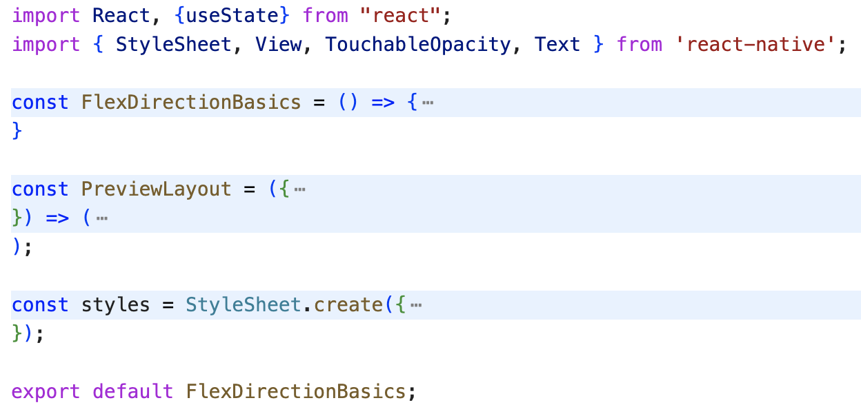
Flex Direction - Demo
Layout
Source code summary:

Slide 22
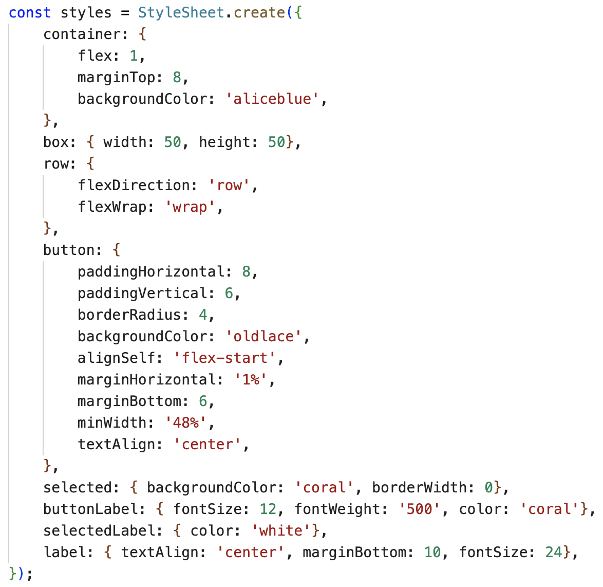
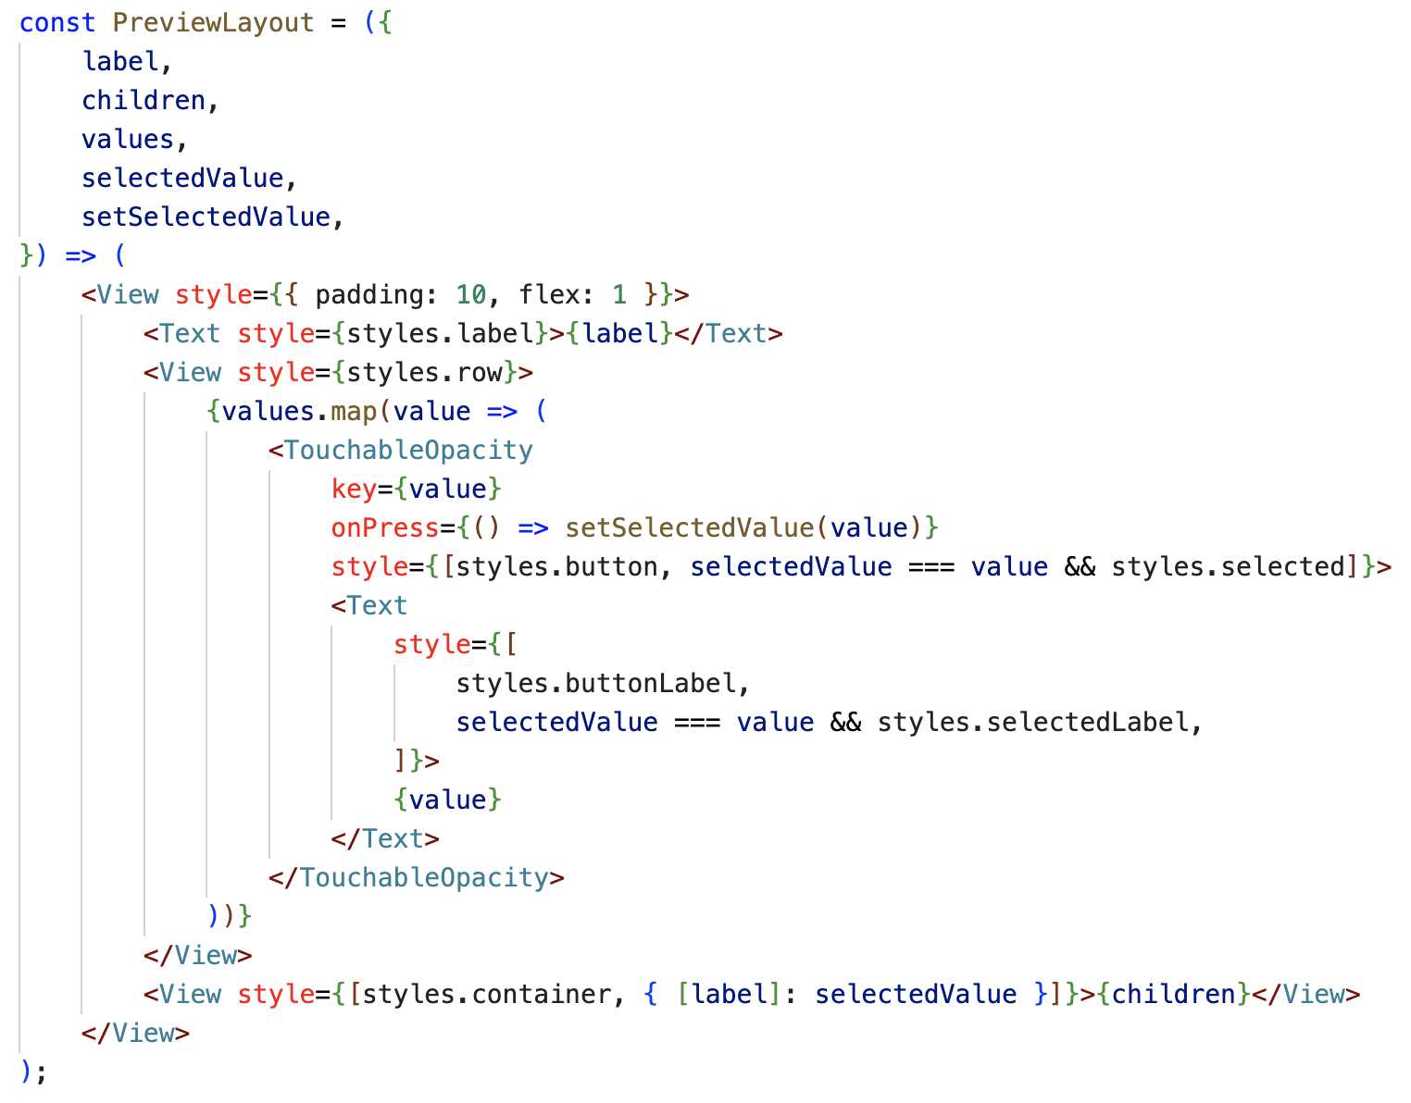
Flex Direction - Demo
Layout

Slide 23
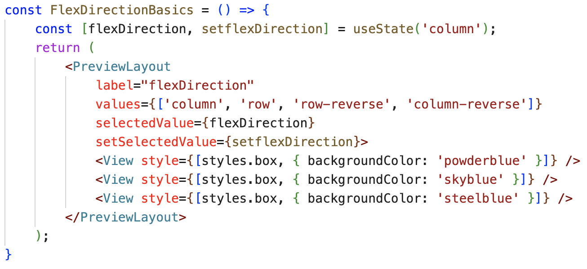
Flex Direction - Demo
Layout

Slide 24
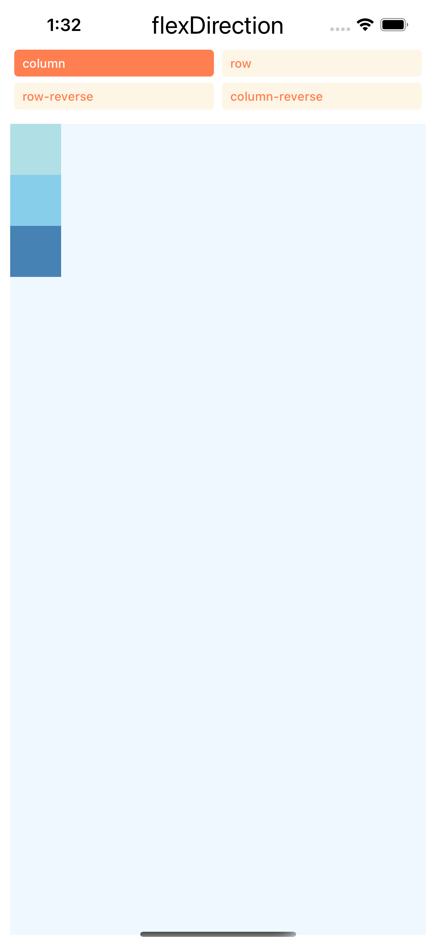
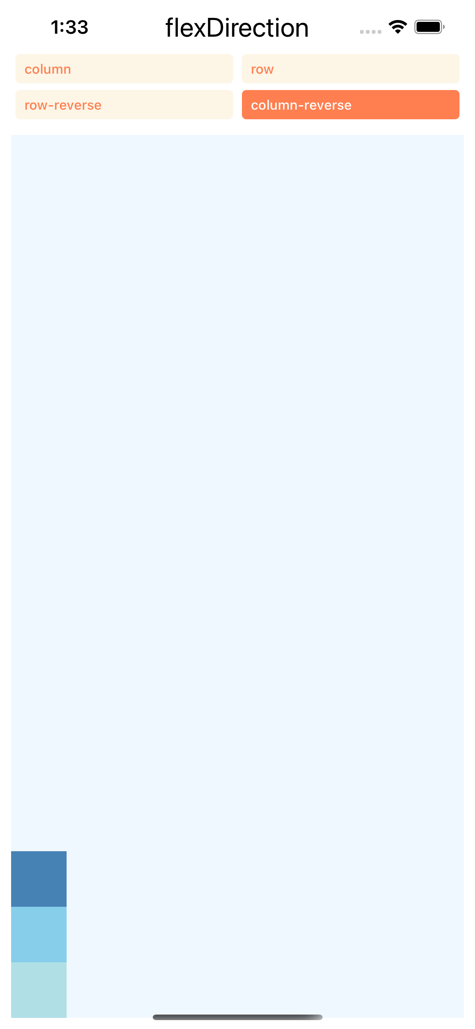
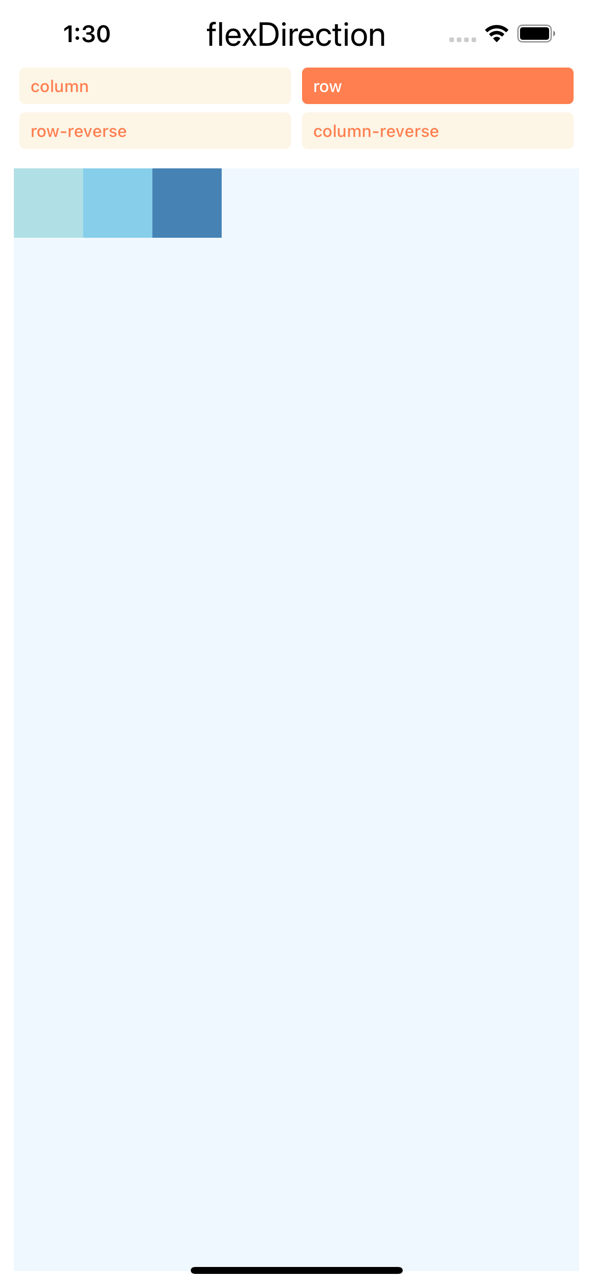
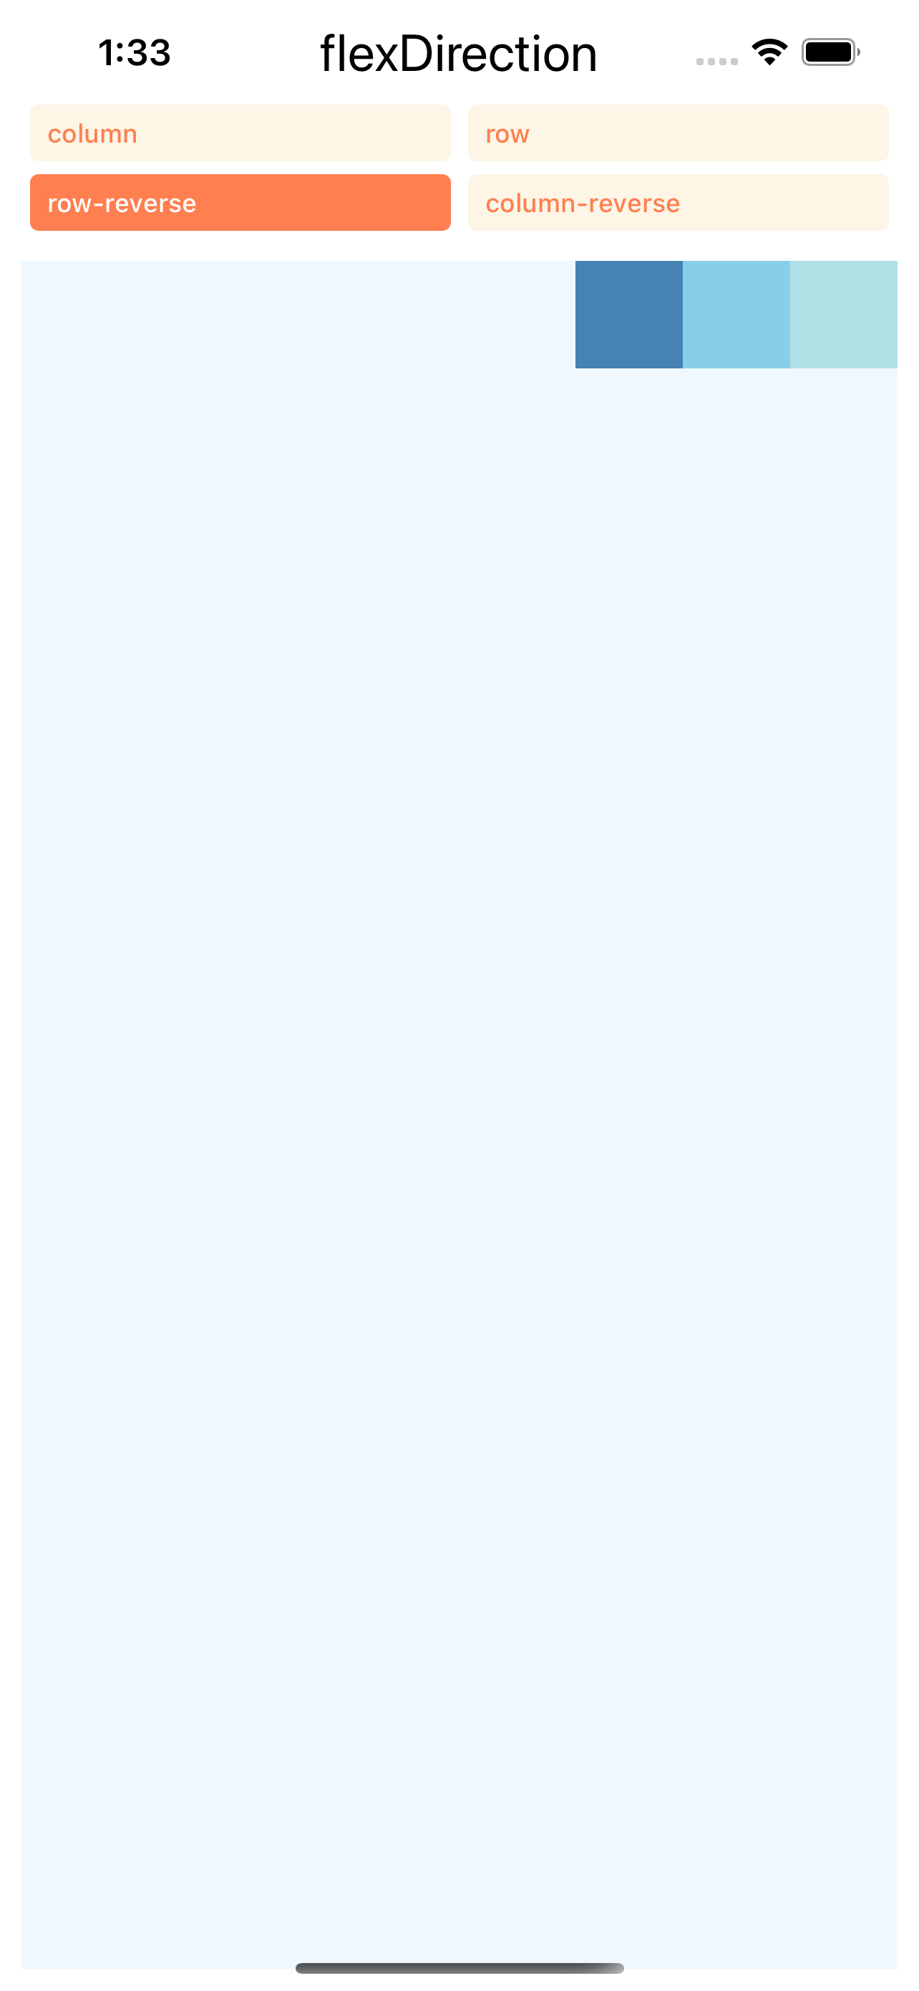
Flex Direction - Ouput
Layout

Slide 25
Layout Direction
Layout
Layout direction specifies the direction in which children and text in a hierarchy should be laid out. Layout direction also affects what edge start and end refer to.
By default, React Native lays out with LTR layout direction. In this mode start refers to left and end refers to right.
LTR (default value): Text and children are laid out from left to right. Margin and padding applied to the start of an element are applied on the left side.
RTL: Text and children are laid out from right to left. Margin and padding applied to the start of an element are applied on the right side.

Slide 26
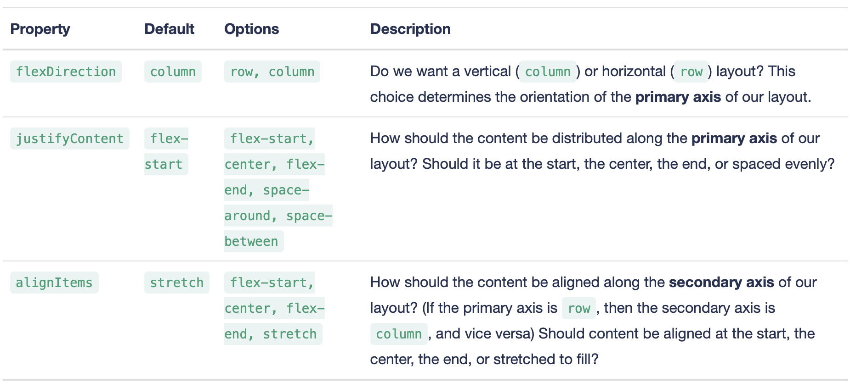
Example
Layout
To choose the right layout for a component's children, we must make 3 choices:

Slide 27
Example
Layout
To choose the right layout for a component's children, we must make 3 choices:

Slide 28
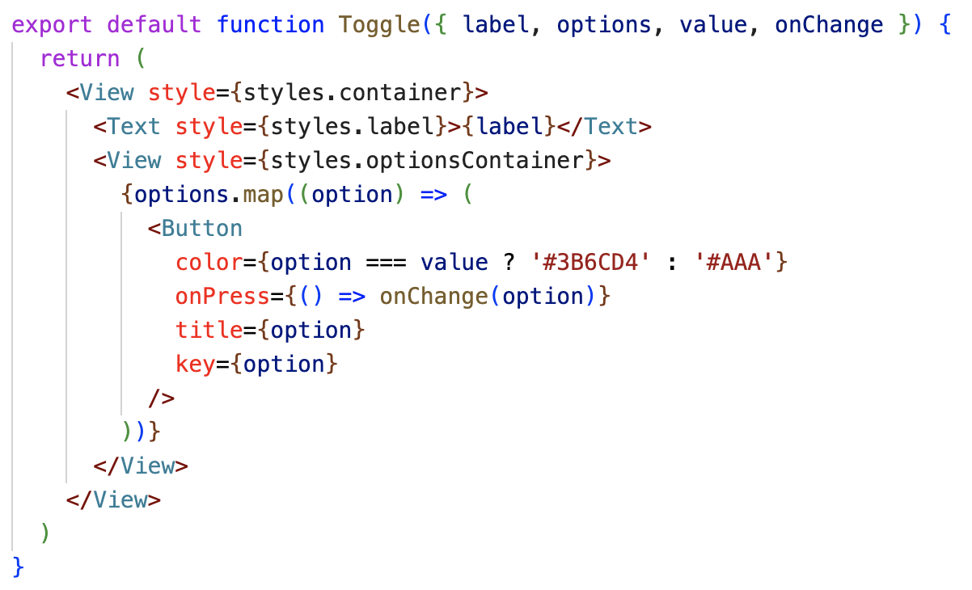
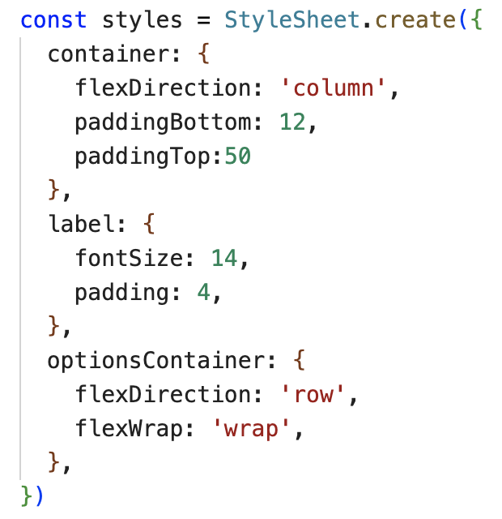
Example
Layout
Toggle.js

Slide 29
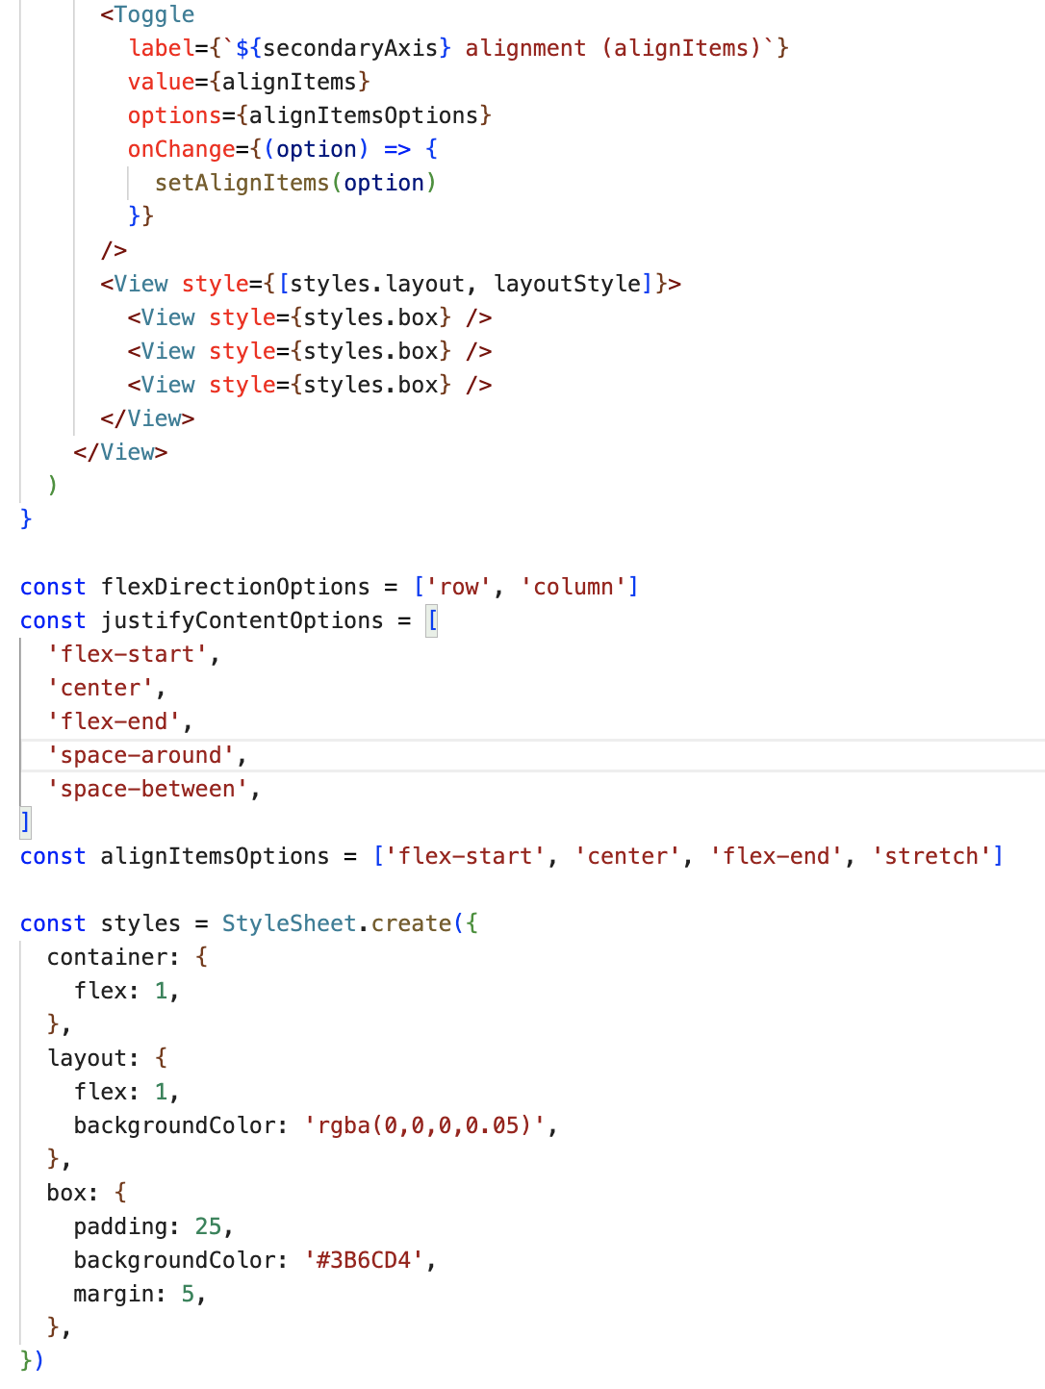
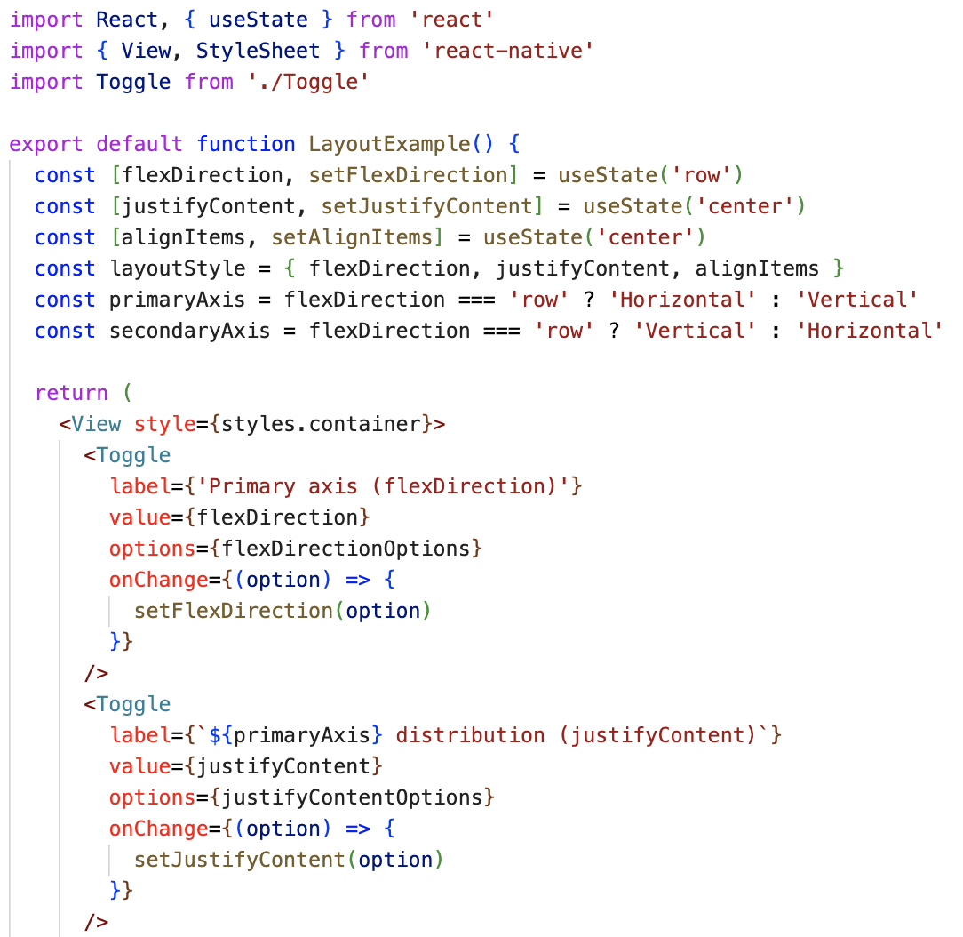
Example
Layout

Slide 30
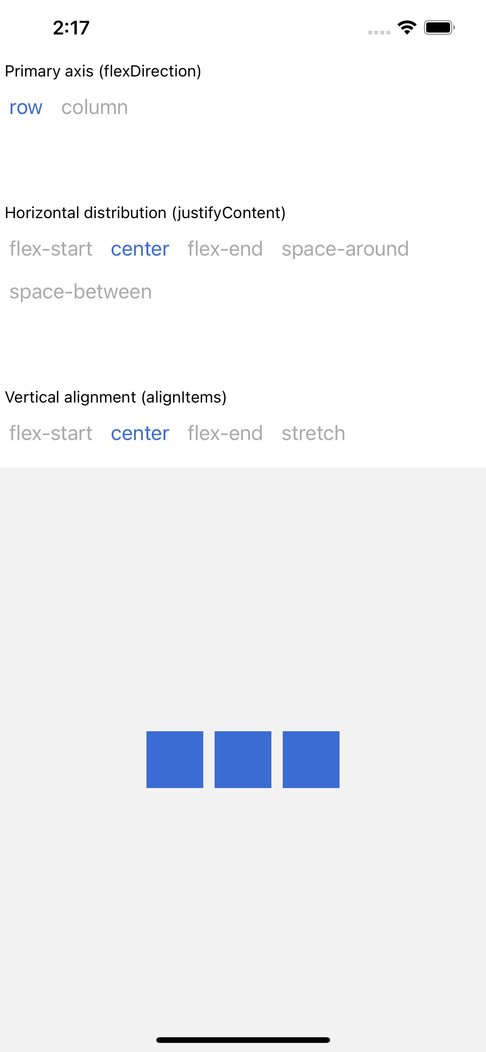
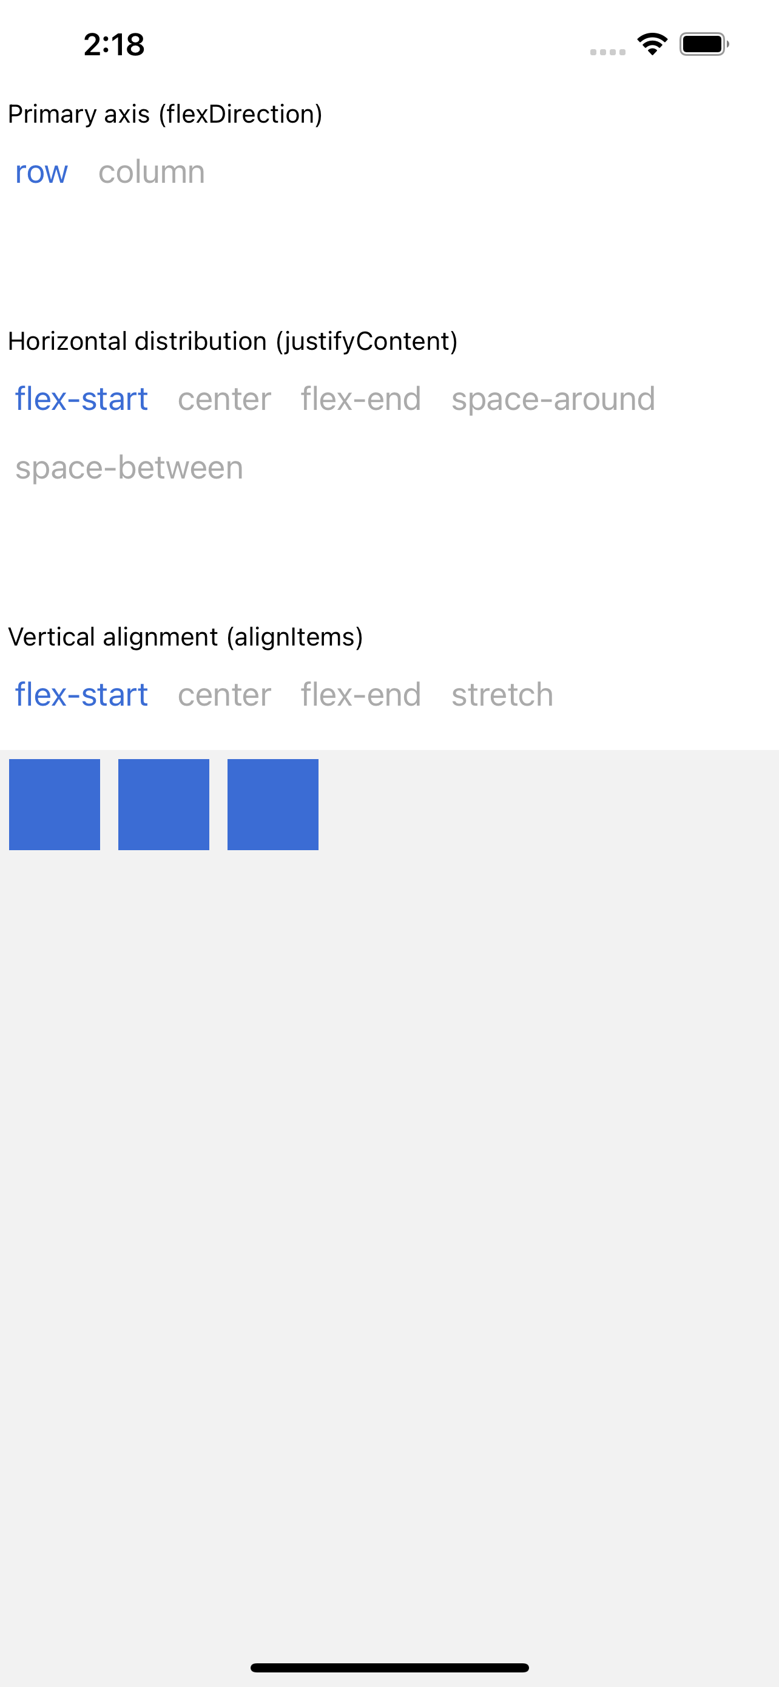
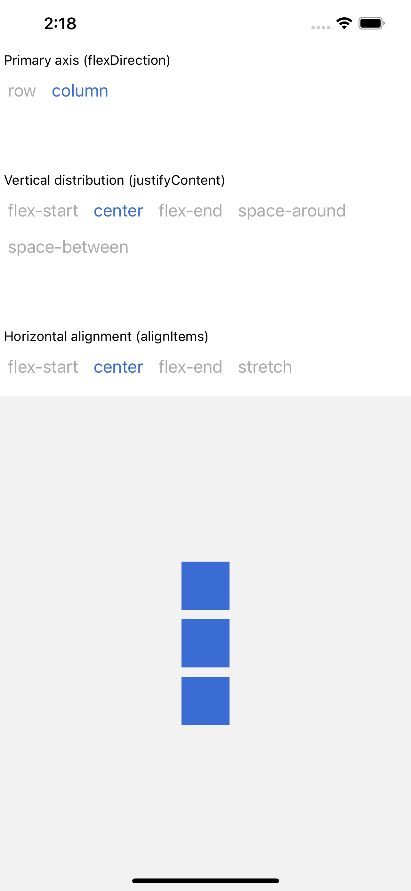
Example - Output
Layout

Slide 31
Summary
In this session, we learned the following:
Understand to styling for React-Native components
Understand set width and height for React Native components
Layouts

